Slide 1
A Community-based Method for
Valence-Arousal Prediction of Affective Words
Liang-Chih Yu
Department of Information Management
Yuan Ze University, Taiwan, R.O.C.

Slide 2
Outline
Introduction
  Categorical and Dimensional Sentiment Analysis
  Valence-Arousal (VA) Space
Related Work
  VA Prediction for affective words and long/short texts
The Proposed Method
  A Community-based Weighted Graph Model
Experimental Results
Conclusions and Future Work
Demo

Slide 3
Introduction
Sentiment Analysis
  Identify and extract opinion/sentiment/subjective information from texts
  Categorical Representation (discrete class)
    Positive or Negative
    Six basic emotions (anger, happiness, fear, sadness, disgust and surprise) (Ekman, 1992)
  Dimensional Representation (continuous value)
    Valence-Arousal (VA) (Russell, 1980)
    Pleasure-Arousal-Dominance (PAD) (Mehrabian, 1996)

Slide 4
Valence-Arousal (VA) Space
Valence
  degree of pleasant and unpleasant (or positive and negative) feelings
Arousal
  degree of excitement and calm
A point in the VA space
represents an affect state
of a word/sentence/document

Slide 5

Categorical Sentiment Analysis
Classify given texts into a set of predefined categories
資料來源: http://dailyview.tw/

Slide 6
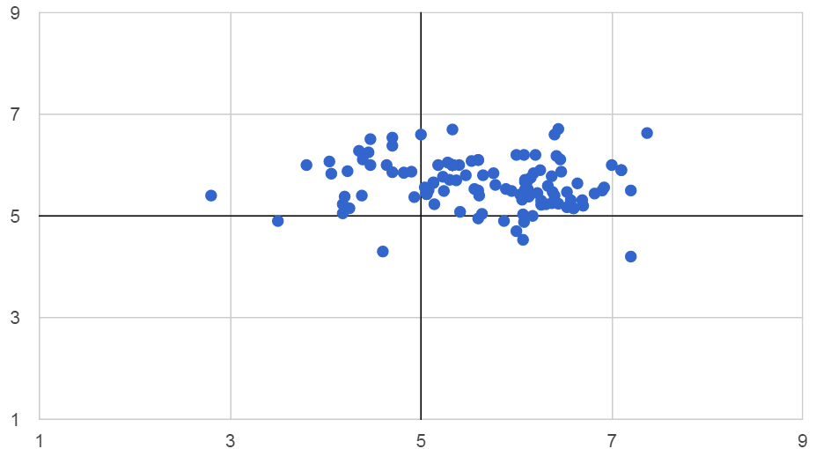
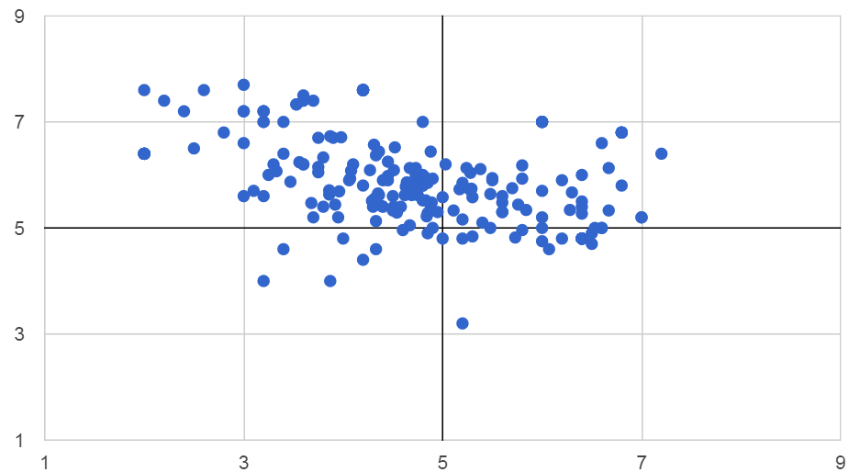
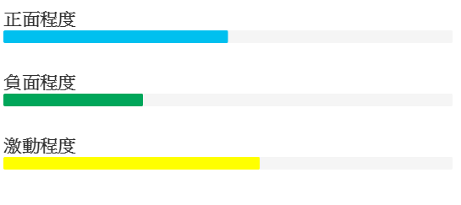
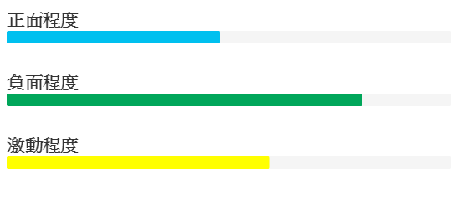
Dimensional Sentiment Analysis
Determine the degrees of valence and arousal of given texts
Provide a more fine-grained sentiment analysis
Two months ago
Latest one month
福斯 volkswagen

Slide 7
Related Work －Sentiment Lexicon
Categorical (Polarity Lexicon)
  General Inquirer
  Liu's Opinion Lexicon
  MPQA Subjectivity Lexicon
  NTU Sentiment dictionary (NTUSD)
  SentiWordNet
  Linguistic Inquiry and Word Count (LIWC)
  Chinese Linguistic Inquiry and Word Count (C-LIWC)
Dimensional (VA Lexicon)
  Affective Norms for English Words (ANEW)
  Warriner's Extended ANEW
  Chinese Valence-Arousal Words (CVAW) (Yu et al., submitted to LREC 2016)

Slide 8
Related Work －Corpora
Categorical
  Chinese Opinion Treebank
  IMDB
  MPQA Opinion Corpus
  Sentiment140
  SemEval
Dimensional
  Affective Norms for English Text (ANET)
  Chinese Valence-Arousal Text (CVAT) (Yu et al., submitted to LREC 2016)
  Stanford Sentiment Treebank

Slide 9
Related Work－Word Level
VA lexicon construction (semi-supervised)
  Predicting VA ratings of unseen words from those of their similar seed words
  Cross-lingual: unseen and seed words
    Linear regression + ontology (Wei et al., 2011)
    Locally-weighted linear regression + similarity (Wang et al., 2015)
  Mono-lingual: unseen and seed words
    Linear regression + Kernel function (Malandrakis et al., 2013)
    Weighted graph model (Esuli and Sebastiani, 2007; Yu et al., 2015)
    SemEval 2015 Task 10 Subtask E for Determining strength of Twitter terms (single dimension)

Slide 10
Related Work－Sentence/Document Level
Predicting VA ratings of short or long texts
Lexicon-based approaches: averaging the VA ratings of all affective words in sentences/documents (Gökçay et al., 2012; Paltoglou et al., 2013)
  Weighted Arithmetic Mean
  Weighted Geometric Mean
  Gaussian Mixture Model

Slide 11
Related Work－Method
Linear regression (Wei et al., 2011; Wang et al., 2015)
  capturing the relationship between the similarities and VA ratings among a set of seed words
    Linear regression + kernel function (Malandrakis et al., 2013)
Graph model (Pagerank) (Esuli and Sebastiani, 2007)
val: valence
Sim: similarity between words
a, b: regression coefficients
N: number of seeds
a: weight of a seed
f: kernel function
Nei: neighbor nodes
α: decay factor
e: constant

Slide 12
The Problem
Traditional methods considered all similar seeds for VA prediction, which may include those with quite different ratings (or an inverse polarity) of valence/arousal to a given word
Unseen word | paradise | 8.72 (valence)
Seed: Rank 1 | heaven | 7.30
Rank 2 | bliss | 6.95
Rank 3 | beautiful | 7.60
Rank 4 | hell | 2.24
Rank 5 | dream | 6.73
Rank 6 | swamp | 5.14
Rank 7 | lonely | 2.17
Rank 8 | carefree | 7.54
Rank 9 | nightmare | 1.91
bliss
(+)
dream
(+)
hell (-)
heaven
(+)
paradise
beautiful
(+)

Slide 13
Other Examples
In ANEW (1,034 words), the ratio of the same and inverse polarity is
  Valence: 7:3 ; Arousal: 6:4
Including such noisy words may reduce the prediction performance
Valence | Actual value | Predicted value | Error | Top 10 most similar neighbors
paradise | 8.72 | 6.73 | 1.99 | heaven (7.30), bliss (6.95), beautiful (7.60), hell (2.24), dream (6.73), swamp (5.14), lonely (2.17), carefree (7.54), nightmare (1.91), glory (7.55)
wealthy | 7.70 | 5.74 | 1.96 | millionaire (8.03), luxury (7.88), handsome (7.93), lavish (6.21), greed (3.51), riches (7.70), famous (6.98), money (7.59), modest (5.76), selfish (2.42)
Arousal | Actual value | Predicted value | Error | Top 10 most similar neighbors
enraged | 7.97 | 6.07 | 1.90 | angry (7.17), disgusted (5.42), frustrated (5.61), displeased (5.64), unhappy (4.18), resent (4.47), startled (6.93), terrified (7.83), upset (5.86), astonished (6.58)
peace | 2.95 | 4.66 | 1.71 | justice (5.47), freedom (5.52), liberty (5.60), war (7.49), life (6.02), bless (4.05), dignified (4.12), disturb (5.80), hope (5.44), mind (5.00)

Slide 14
Possible Solutions (1/2)
An ideal prediction method should
  account for seeds with the same polarity to an unseen word
  exclude those with an inverse polarity (noisy words)
  k-NN: select top k most similar words as nearest neighbors
  ε-NN: select nearest neighbors by introducing a similarity threshold ε
bliss
(+)
dream
(+)
hell (-)
High similar words with an inverse polarity could not be excluded
heaven
(+)
paradise
beautiful
(+)
threshold

Slide 15
Possible Solutions (2/2)
Graph partition methods
  mincut/max-flow mincut: the edges with a lower degree of similarity to the unseen word were cut off
The idea is similar to k-NN and ε-NN, both are similarity-based methods
bliss
(+)
dream
(+)
hell (-)
heaven
(+)
paradise
beautiful
(+)

Slide 16
The Proposed Method
Community-based weighted graph model
  Community detection method for selecting seeds which are both similar to and have similar ratings or the same polarity with unseen words
  Weighted graph model for predicting VA ratings of words from such high-quality seeds
A word may have more similar neighbors with the same polarity than with an inverse polarity

Slide 17
Community-based Weighted Graph Model
Given an unseen word and a set of seed words
Calculate the similarities between the unseen word and seed words
Construct a weighted graph where
  each node represents a word and
  each edge represents the similarity between two nodes
A community detection method is used to select similar neighbors with the same polarity into the same community
The VA ratings of the unseen word are estimated from its community members using the weighted graph model
(weight = similarity score)

Slide 18
Similarity Calculation
Continuous vector representations for words
Word vectors are trained on a large corpus (e.g., Wiki) using word2vec (Mikolov et al., 2013a; 2013b)
Cosine distance between word vectors is adopted to measure the word similarity

Slide 19
Weighted Graph Model
The seeds more similar to the unseen word may contribute more to the estimation process
Pagerank (Esuli and Sebastiani, 2007)
  Weighted graph model (Yu et al., 2015)

Slide 20
Community Detection Method
The community detection method divides a graph into several communities (sub-graphs)
Each community tends to consist of a set of similar words with the same polarity
  densely connected internally
  sparsely connected between
  different communities

Slide 21
Modularity
A modularity value is introduced to measure the associations within and between communities over a graph (Newman, 2006; Blondel et al., 2008)
The goal is to search for a partition that maximizes the modularity over the graph
This can be accomplished by
iteratively repeating
  modularity optimization step
  community merge step

Slide 22
Modularity Optimization Step (1/2)
Initially, each word in the graph is assigned to a distinct community
Each word is then sequentially moved from the original community to all its neighbor communities
  A movement will lead to a change of modularity

Slide 23
Modularity Optimization Step (2/2)
After trying the movements to all neighbor communities, the movement
  yielding the highest ΔM will be taken,
  and only if ΔM is positive
Otherwise, the word will stay in the original community
The movement procedure is performed sequentially and repeatedly for all words in the graph until no positive ΔM is found for all movements

Slide 24
Community Merge Step
The communities found in the previous step are treated as new nodes to build a new weighted graph
The weight of each edge between two nodes (communities) is calculated by the sum of the weights between all words in the two communities
Two communities are considered neighbor nodes if they have at least one edge between them
The new graph is then passed back to the previous step
These two steps are iteratively performed until no more new communities are found

Slide 25
VA Prediction
In testing, an unseen word is moved into all communities to calculate the changes of modularity ΔM
It will be finally assigned to the community with a highest ΔM
Only the neighbors in the community are included in the prediction process
Those in different communities are ignored so as to exclude noisy neighbors

Slide 26
Experiment Settings (1/2)
Datasets
  ANEW (1,034 English words)
  CVAW (1,653 Chinese words)
  Development set (20%) for optimal parameter selection
  Test set (80%) with 5-fold cross-validation for performance evaluation
Evaluation Metrics
  Root mean square error (RMSE)
  Mean absolute error (MAE)
  Pearson correlation coefficient (r)

Slide 27
Experiment Settings (2/2)
Compare the weighted graph model to other prediction models
  Linear regression
  Kernel function
  pagerank
Compare the community detection method to other neighbor selection methods based on the weighted graph model
  k-NN/ε-NN
  mincut/max-flow mincut

Slide 28
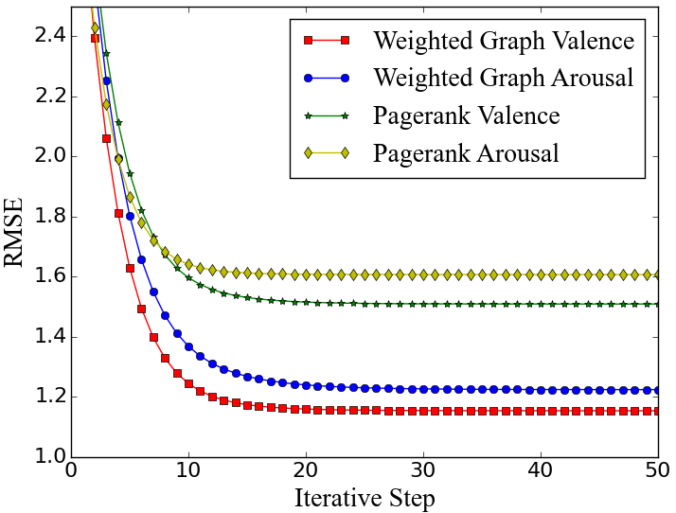
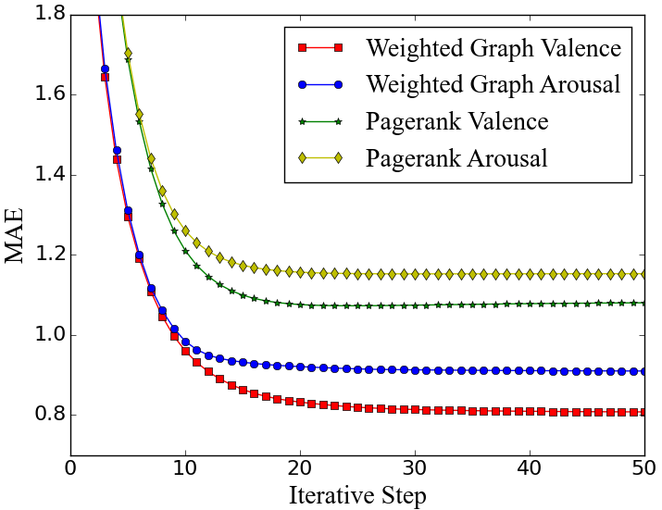
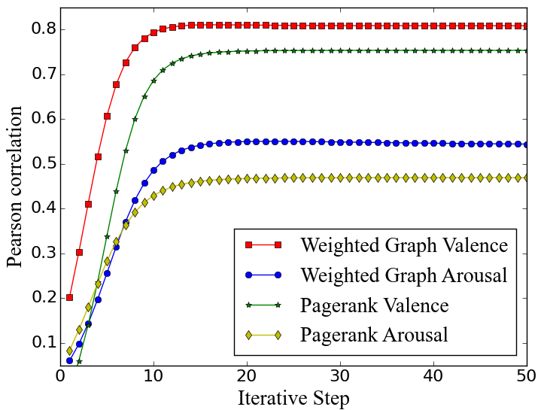
Evaluation on Weighted Graph Model (1/2)
Iterative Results of Graph-based Methods
  Pagerank
  Weighted graph model

Slide 29
Evaluation on Weighted Graph Model (2/2)
Valence | ANEW (English) |  |  | CVAW (Chinese)
 | RMSE | MAE | r | RMSE | MAE | r
Kernel | 1.871 | 1.381 | 0.612 | 1.834 | 1.367 | 0.632
Linear Regression | 1.813 | 1.322 | 0.624 | 1.786 | 1.298 | 0.645
PageRank | 1.508 | 1.079 | 0.753 | 1.524 | 1.142 | 0.718
Weighted Graph | 1.152 | 0.807 | 0.805 | 1.148 | 0.884 | 0.786
Arousal | ANEW (English) |  |  | CVAW (Chinese)
 | RMSE | MAE | r | RMSE | MAE | r
Kernel | 1.854 | 1.365 | 0.417 | 1.842 | 1.363 | 0.403
Linear Regression | 1.804 | 1.328 | 0.428 | 1.807 | 1.325 | 0.416
PageRank | 1.606 | 1.152 | 0.469 | 1.588 | 1.136 | 0.466
Weighted Graph | 1.223 | 0.909 | 0.544 | 1.218 | 0.902 | 0.542

Slide 30
Error Analysis
In ANEW (1,034 words), the ratio of the same and inverse polarity is
  Valence: 7:3 ; Arousal: 6:4
Valence | Actual value | Predicted value | Error | Top 10 most similar neighbors
paradise | 8.72 | 6.73 | 1.99 | heaven (7.30), bliss (6.95), beautiful (7.60), hell (2.24), dream (6.73), swamp (5.14), lonely (2.17), carefree (7.54), nightmare (1.91), glory (7.55)
wealthy | 7.70 | 5.74 | 1.96 | millionaire (8.03), luxury (7.88), handsome (7.93), lavish (6.21), greed (3.51), riches (7.70), famous (6.98), money (7.59), modest (5.76), selfish (2.42)
funeral | 1.39 | 3.25 | 1.86 | burial (2.05), cemetery (2.63), coffin (2.56), wedding (7.82), morgue (1.92), grief (1.69), church (6.28), family (7.65), tomb (2.94), bereavement (4.57)
sad | 1.61 | 3.44 | 1.83 | regretful (2.82), terrible (1.93), happy (8.21), pity (3.37), disgusted (2.45), thankful (6.89), lonely (2.17), grateful (7.37), cruel (1.97), stupid (2.31)
Arousal | Actual value | Predicted value | Error | Top 10 most similar neighbors
enraged | 7.97 | 6.07 | 1.90 | angry (7.17), disgusted (5.42), frustrated (5.61), displeased (5.64), unhappy (4.18), resent (4.47), startled (6.93), terrified (7.83), upset (5.86), astonished (6.58)
ambulance | 7.33 | 5.35 | 1.98 | hospital (5.98), taxi (3.41), bus (3.55), nurse (4.84), truck (4.84), trauma (6.33), doctor (5.86), morgue (4.84), accident (6.26), vehicle(4.63)
bored | 2.83 | 4.62 | 1.79 | frustrated (5.61), lazy (2.65), addicted (4.81), fatigued (2.64), confused (6.03) mad (6.76), lonely (4.51), seasick (5.80), scared (6.82), discouraged (4.53)
peace | 2.95 | 4.66 | 1.71 | justice (5.47), freedom (5.52), liberty (5.60), war (7.49), life (6.02), bless (4.05), dignified (4.12), disturb (5.80), hope (5.44), mind (5.00)

Slide 31
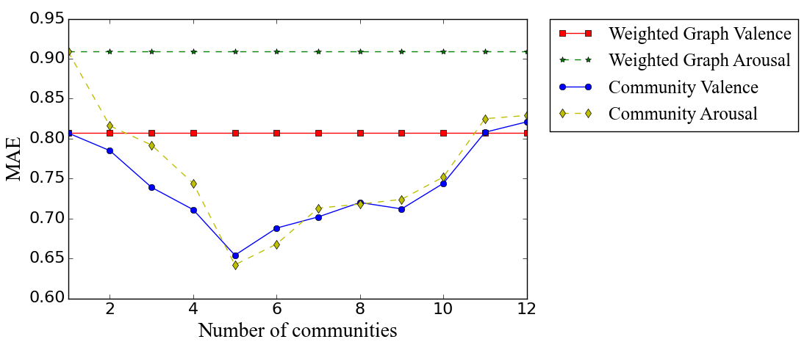
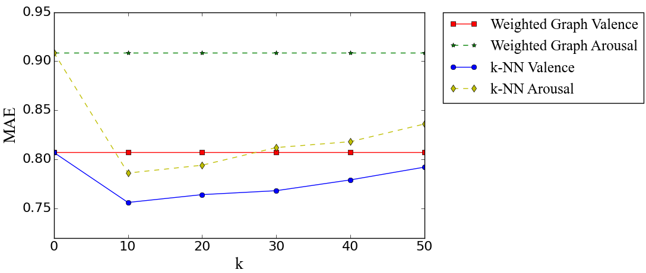
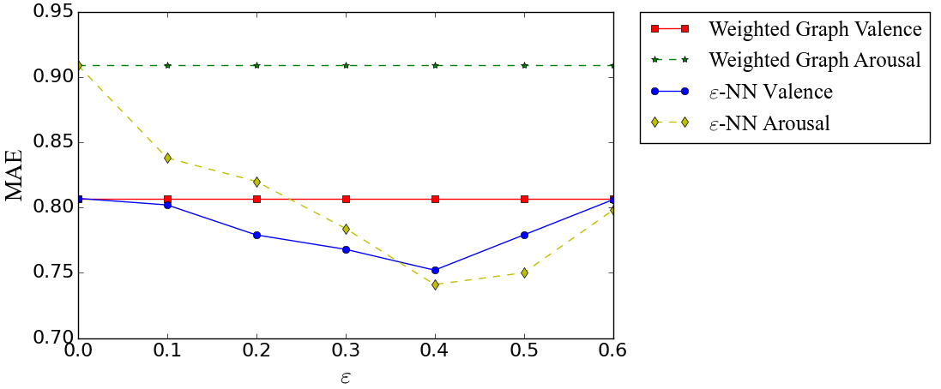
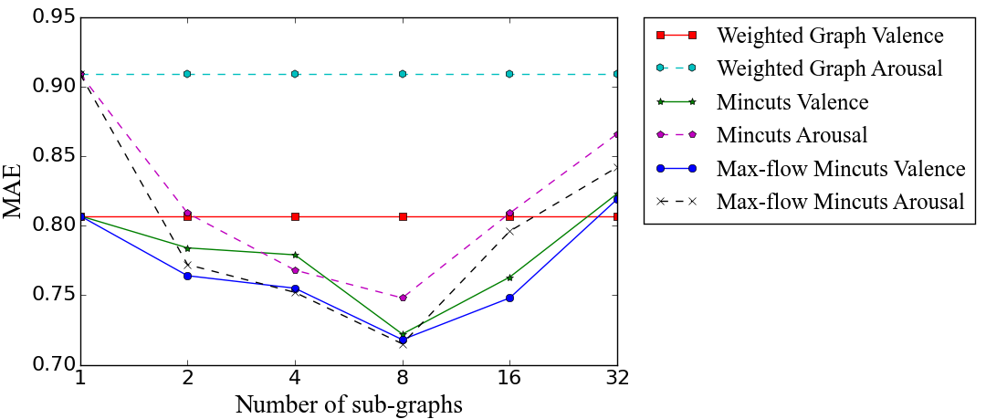
Evaluation on Community-based Method (1/3)
Optimal parameter selection

Slide 32
Evaluation on Community-based Method (2/3)
Valence | ANEW (English) |  |  |  | CVAW (Chinese)
 | RMSE | MAE | r | Inverse Polarity | RMSE | MAE | r | Inverse Polarity
Weighted graph model | 1.152 | 0.807 | 0.805 | 29.30% | 1.148 | 0.884 | 0.786 | 28.66%
with k-NN (k=10) | 1.025 | 0.756 | 0.824 | 21.56% | 1.053 | 0.875 | 0.818 | 20.86%
with ε-NN (ε=0.4) | 1.018 | 0.750 | 0.822 | 20.83% | 0.971 | 0.826 | 0.832 | 20.46%
with mincuts | 0.967 | 0.735 | 0.828 | 20.35% | 0.977 | 0.828 | 0.834 | 19.86%
with max-flow mincuts | 0.915 | 0.728 | 0.835 | 19.78% | 1.004 | 0.859 | 0.822 | 20.31%
with community | 0.812 | 0.645 | 0.915 | 10.95% | 0.890 | 0.770 | 0.897 | 10.33%

Slide 33
Evaluation on Community-based Method (3/3)
Valence | ANEW (English) |  |  |  | CVAW (Chinese)
 | RMSE | MAE | r | Inverse Polarity | RMSE | MAE | r | Inverse Polarity
Weighted graph model | 1.223 | 0.909 | 0.544 | 39.96% | 1.158 | 0.902 | 0.542 | 35.18%
with k-NN (k=10) | 1.044 | 0.786 | 0.560 | 28.66% | 1.060 | 0.840 | 0.549 | 30.81%
with ε-NN (ε=0.4) | 0.948 | 0.745 | 0.571 | 28.49% | 1.008 | 0.819 | 0.554 | 29.72%
with mincuts | 0.934 | 0.739 | 0.576 | 28.23% | 0.945 | 0.739 | 0.592 | 28.95%
with max-flow mincuts | 0.923 | 0.716 | 0.583 | 27.96% | 0.935 | 0.726 | 0.596 | 28.83%
with community | 0.791 | 0.628 | 0.685 | 21.93% | 0.806 | 0.613 | 0.694 | 20.79%

Slide 34
Conclusions
This study presents a community-based weighted graph model for word-level valence-arousal prediction
The proposed method selects useful neighbors for each unseen word by considering overall associations between words in the graph
Experiments on both English and Chinese affective lexicons show that the weighted graph model yielded better performance than previously proposed methods
The use of community-based neighbor selection can further improve the performance of the weighted graph model

Slide 35
Future Work
Sentence-level valence-arousal prediction
Sentence Embeddings based on word vectors
  Issue: Two sentences contain semantically similar words but their VA ratings or polarity are different
  Example: sad and happy may have similar word vectors, which means that two sentences containing these words may have similar sentence vectors
Sentence Embeddings based on paragraph vector

Slide 36
Reference
V. D. Blondel, J. L. Guillaume, R. Lambiotte, and E. Lefebvre, “Fast unfolding of communities in large networks,” Journal of Statistical Mechanics: Theory and Experiment, no. 10, pp. 10008, 2008.
P. Ekman, “An argument for basic emotions,” Cognition and emotion, vol. 6, no. 3-4, pp. 169-200, 1992.
A. Esuli, and F. Sebastiani F, “Pageranking wordnet synsets: An application to opinion mining,” in Proc. ACL, 2007, pp. 442-431.
D. Gökçay, E. Işbilir, G. Yıldırım, “Predicting the sentiment in sentences based on words: An Exploratory Study on ANEW and ANET,” in Proc. CogInfoCom, 2012, pp. 715-718.
N. Malandrakis, A. Potamianos, E. Iosif, and S. Narayanan, “Distributional semantic models for affective text analysis,” IEEE Trans. Audio, Speech, and Language Processing, vol. 21, no. 11, pp. 2379-2392, 2013.
A. Mehrabian, Pleasure-Arousal-Dominance: A General Framework for Describing and Measuring Individual, Current Psychology, vol. 15, no. 4, pp. 505-525, 1996.
T. Mikolov, K. Chen, G. Corrado, and J. Dean, “Efficient estimation of word representations in vector space,” in Proc. ICLR, 2013a.
T. Mikolov, I. Sutskever, K. Chen, G. Corrado, and J. Dean, “Distributed representations of words and phrases and their compositionality,” in Proc. NIPS, 2013b, pp. 3111-3119.

Slide 37
Reference
M. E. Newman, “Modularity and community structure in networks,” in Proc. National Academy of Sciences, vol. 103, no. 23, pp. 8577-8582, 2006.
G. Paltoglou, M. Theunis, A. Kappas, and M. Thelwall, “Predicting emotional responses to long informal text,” IEEE Trans. Affective Computing, vol. 4, no. 1, pp.106-115, 2013.
D. Rao, and D. Ravichandran, “Semi-supervised polarity lexicon induction,” in Proc. EACL, 2009, pp. 675–682.
J. A. Russell, “A circumplex model of affect,” Journal of personality and social psychology, vol. 39, no. 6, pp. 1161, 1980.
J. Wang, L. C. Yu, K. R. Lai and X. Zhang, “Predicting Valence-Arousal Ratings of Words Using a Weighted Graph Method,” in Proc. ACII, 2015, pp. 415-420
W. L. Wei, C. H. Wu, and J. C. Lin, “A regression approach to affective rating of Chinese words from ANEW,” in Proc. ACII, 2011, pp. 121-131.
L. C. Yu, J. Wang, K. R. Lai and X. Zhang, “Predicting Valence-Arousal Ratings of Words Using a Weighted Graph Method,” in Proc. ACL, 2015, pp. 788-793.
L. C. Yu et al., “Building Chinese Affective Resources in Valence-Arousal Dimensions,” submitted to LREC 2016.

