Slide 1
Capture the great moment of social network efficiently and effectively
PRESENTED BY: Shih-En
2015/12/18 IR Workshop
elliot@qsearch.cc

Slide 2
周世恩(Elliot), QSearch Co-Founder
Now…I’m in substitute military service.
Notes:
首先我會介紹這研究的時空背景，以及我參與的動機 再來會提到做研究時遇到Crawling 相關的問題

Slide 3
Notes:
首先我會介紹這研究的時空背景，以及我參與的動機 再來會提到做研究時遇到Crawling 相關的問題

Slide 4
History of QSearch
Start a company
ASIA Beat Startup Competition
FlyingV
SSW Startup Competition
2013, Jan
2014, Mar
2014,11.29
2014.12.03
2012, Jun
2014, Jan
2014, Sep
Just for fun
Echelon Startup Competition
Taipei Mayoral Election
2014, May
2014, Sep
2015.Apr
2012, Jun
2013, Jun
Build Dynamical Crawling Clusters
Multi-thread Crawling

Slide 5
Core Architecture
Data Cleansing and Integration
Data mining
Bi-directional integration
Data Collection
Schema Matching
Record linkage
NLP/NER
Classification
Reporting
Distributed Crawler

Slide 6
Outline:
Background and Motivation
System Overview:
Architecture, scheduling policy, and freshness measurement
Experiment & Data:
Data analysis, feature importance, and crawling performance
Future Work
Notes:
首先我會介紹這研究的時空背景，以及我參與的動機 再來會提到做研究時遇到Crawling 相關的問題

Slide 7
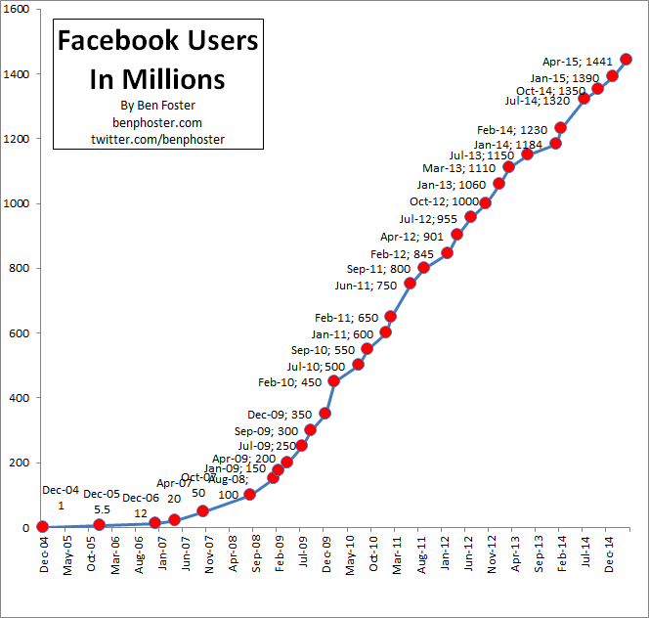
Background
Facebook monthly active user exceed 1.3 billion in 2014 Q4.
Social media data capture our social interactions and desires
Ref: http://www.benphoster.com/facebook-user-growth-chart-2004-2010/

Slide 8
Background
In fact, Our customers want to know…
Who’s our active user?
The people who like my page also like …?
What is popular right now?
Who is talking my brand?
How’s the marketing strategy?
…
Facebook monthly active user exceed 1.3 billion in 2014 Q4.
Social media data capture our social interactions and desires
Notes:
Let’s talk about the users demand.

Slide 9
Background
Our customers want to know more…
Hmmm…. Who’s bullying me now?
How’s your coverage?
If there are some emerging pages, can you help collect them?
Facebook monthly active user exceed 1.3 billion in 2014 Q4.
Social media data capture our social interactions and desires

Slide 10
Problems
To solve our clients problems,
How often do we need to do snapshots?
How do we know that we have enough data?
For Social network:
Due to limited API access request times, it’s not easy to crawl all posts or refresh the local database.
Notes:
用最小的資源，做Facebook最新的Snapshot，
----- 會議記錄 (6/29/15 12:37) -----
不應該出現 limited resources.
(1) 怎樣才能抓到變動
(2) Metric怎麼決定
什麼是 User behaviors evolution
-------
連結邏輯

Slide 11
Difference
Time
…
Snapshot X
Snapshot1
Snapshot2
Snapshot3

Slide 12
Problems
Money & Limited Resource
Especially for self-fund startup… ☹
How often do we need to do snapshots?
How do we know that we do the complete snapshots?
Social network:
Due to lack of temporal information, it’s not easy to capture how the number of likes increase over time.
For Social network:
Due to limited API access request times, it’s not easy to crawl all posts or refresh the local database.
For Startup:
Need money to purchase instances and network bandwidth.
Notes:
用最小的資源，做Facebook最新的Snapshot，
----- 會議記錄 (6/29/15 12:37) -----
不應該出現 limited resources.
(1) 怎樣才能抓到變動
(2) Metric怎麼決定

Slide 13
System Overview
Notes:
Let’s take a glance of API design.

Slide 14
Data flow of social stream crawler
Facebook 3rd party user login module
Access Token, UID
Network explorer module
Post DB
DataStore module
SeedID
SeedID
Entity DB
Structured Data
Initial seeds file
Structured data
extraction module
Social Activity DB
SeedID
Social Activity Statistics (e.g., the number of like)
Web Content
Scheduler
URL
Social Stream Crawling module
URL
Web Content
Social Network API
Notes:
Right now, We have more than 200 instances for crawling
We collect about 10TB in recent 3 months.
Dynamic !!!!!

Slide 15
Scheduler
Social Activity
DB
Feature Vector Generator
Learning
Algorithm
Predictive
Model
Training
Ranking
Seed IDs
Feature Vector Generator
Crawling Priority
Manager
Request Manager
Crawlers
Engine Module

Slide 16
Capture the posts created during
Target
Period size
Overall engagement in N day
N days ago
Long-term
Same time slot
…
…
Overall engagement in N day
2 days ago
Same time slot
Overall engagement in N day
Yesterday
Short-term
Same time slot
Overall engagement
Today
Latest
Target
Latest crawling
Crawler starts
0h
1h
2h
3h
4h
…
18h
19h
20h
21h
22h
23h
24h
Notes:
Summary 一下feature:
----- 會議記錄 (6/27/15 19:05) -----
改圖
----- 會議記錄 (6/29/15 13:07) -----
要補helper

Slide 17
Scheduling policy
Identify Popular levels
of each page
Collect the activities
of each page
Build scheduling model with ML library
Rank crawling priority &
Update crawling frequency
Notes:
----- 會議記錄 (6/29/15 13:07) -----
應該先談Scheduling policy
再談 features
----
強調Data 有temporal 特質
應該有period feature.

Slide 18
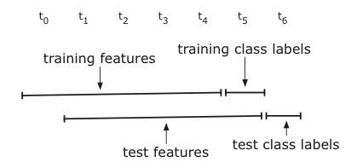
Scheduling policy
Label: (The value has been applied log operation) (1) Binary Classification
(2) Multiple Magnitude Classification
Machine learning library: (1) Support vector machine
(2) Random forest
Prediction: (1) Rank by estimating probability(Classification)
(2) Rank by estimating value (Regression)
Notes:
----- 會議記錄 (6/29/15 13:07) -----
應該先談Scheduling policy
再談 features
----
強調Data 有temporal 特質
應該有period feature.

Slide 19
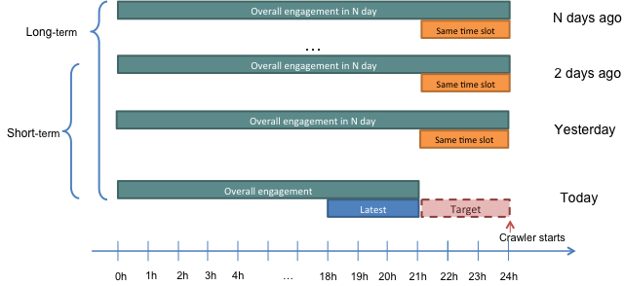
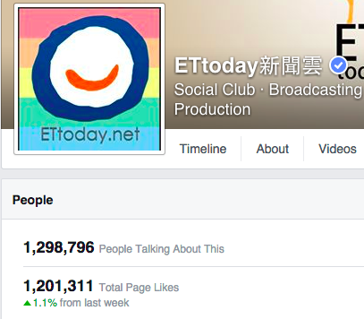
Selected Features
Simple Features:
Latest collected engagements
Overall engagements at the same time slot in N days
Overall engagements in N days / Average engagements in N days
Taking about count
Notes:
Summary 一下feature:
----- 會議記錄 (6/27/15 19:05) -----
改圖

Slide 20
Adjust the crawling frequency
Model publication frequency
Time Window
e₁
P_{1,1}
P_{1,7}
P_{1,j}
Publication frequency

Slide 21
Measure Freshness & Delay
Freshness: count the number of missed posts
Delay:
Notes:
補描述
----- 會議記錄 (6/29/15 13:07) -----
沒有講清楚物理意義

Slide 22
Experiment
Notes:
Talk about the future

Slide 23
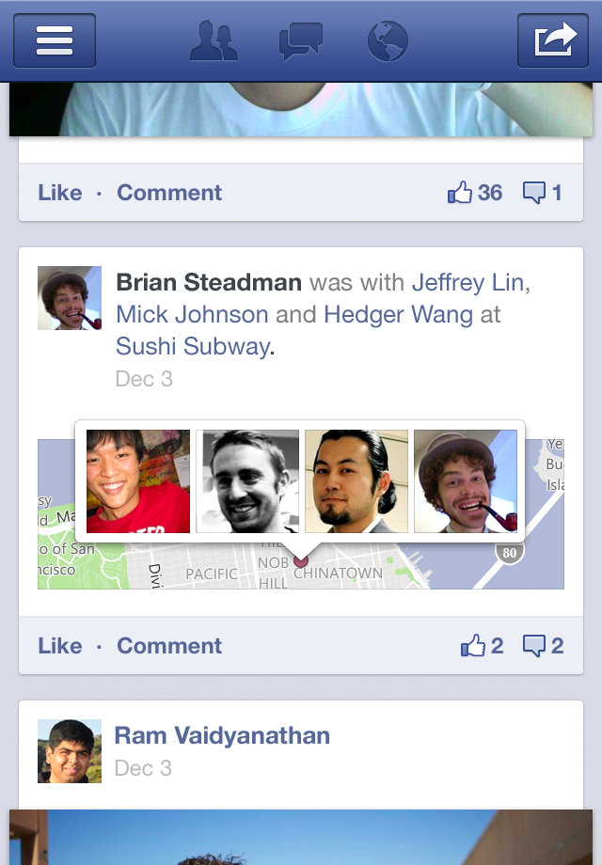
Data
April 1, 2015 ~ April 30, 2015
Facebook Fan Page: 637K
790 million posts
Over 25 billion likes
Notes:
----- 會議記錄 (6/29/15 13:07) -----
眼球移動問地

Slide 24
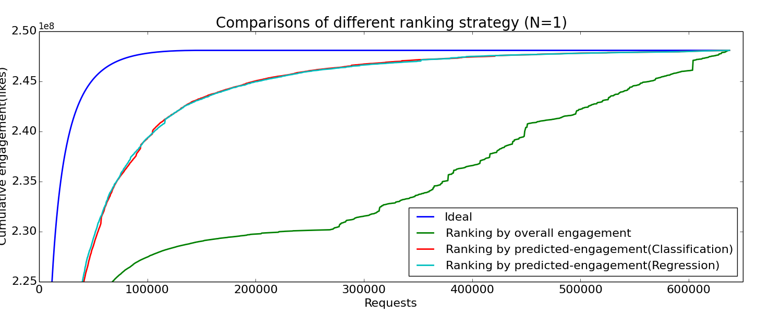
Coverage - Multiple magnitude classification vs. Regression
Setup period size=1 and consider the activity log(N) during the past 1 day.

Slide 25
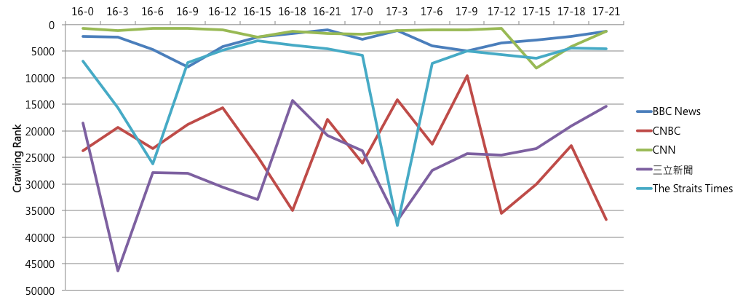
This time series data is in Taipei Time (+0800). We select 5 news media related fan pages around the world. The crawling rank of BBC are prior than The Straits Times and 三立新聞.
Notes:
----- 會議記錄 (6/29/15 13:07) -----
舉Dynamic 的example
----

Slide 26
Rank
Active time
Datetime(format: DD-HH)
Active time
Active time
**These 3 pages are added in 4/15
Notes:
模擬加入幾個粉絲頁，觀察隨著social activity 歷史資料的累積，是否ranking 會越來越“穩定”
意外發現，英國用戶晚上用FB的狀況不會使用到半夜

Slide 27
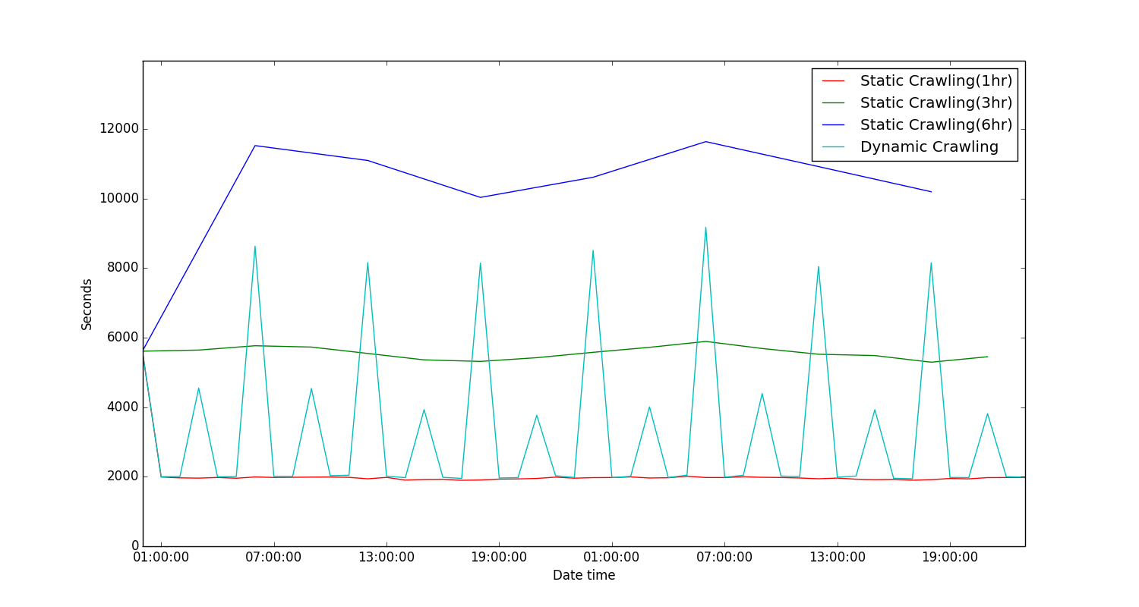
Freshness – Delay

Slide 28
Future
Notes:
Talk about the future

Slide 29
Problems
How often do we need to do snapshots?
How do we know that we do the complete snapshots?
Social network:
Due to lack of temporal information, it’s not easy to capture how the number of likes increase over time.
We need more
Support
Especially for self-fund startup… ☺

Slide 30
Core Architecture
Data Cleansing and Integration
Data mining
Bi-directional integration
Data Collection
Schema Matching
Record linkage
NLP/NER
Classification
Reporting
Distributed Crawler

Slide 31
Developing
Expand our Crawling Clusters
Name Entity Extraction and Mapping for Social Media.
e.g., Product Name, 馬芙丸(馬英九),
Post Generator in Chinese.
Large-Scale Word Clustering
Sentiment Analysis for Social Media
e.g., concern troll detection
Image Recognition

Slide 32
Q & A
elliot@qsearch.cc

