Slide 1
Jointly Modeling Topics, Events and User Interests on Twitter
Qiming Diao Jing Jiang
School of Information Systems
Singapore Management University

Slide 2
Some Facts about Twitter
284 million monthly active users
500 million Tweets are sent per day
80% of Twitter active users are on mobile
77% of accounts are outside the U.S.
Statistics collected in December 2014

Slide 3
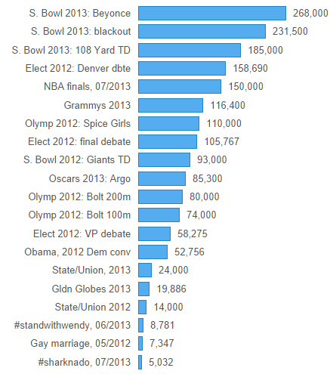
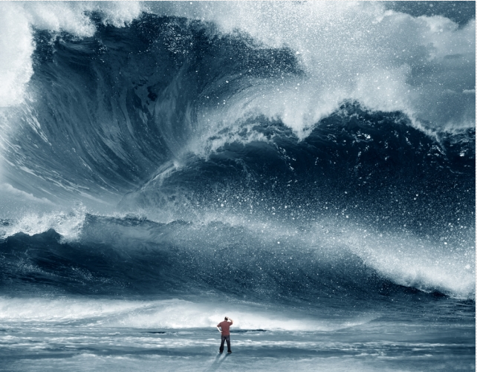
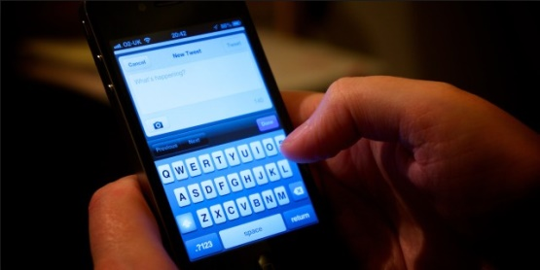
Events on Twitter
20 big moments on Twitter
The volume of tweets on an event shows its popularity
Tweets per minute
https://blog.twitter.com/2013/behind-the-numbers-how-to-understand-big-moments-on-twitter

Slide 4
Event Identification
Can we identify the major events tweeted on Twitter within a certain period?
Identify event-related tweets
Cluster these tweets such that each cluster is a single event
Rank the clusters by volume

Slide 5
Event Analysis
Can we characterize events by linking them to general topics?
E.g. football games and Olympic games are related to sports, whereas presidential debates are related to politics
Can we link events to users’ personal preferences?
E.g. User A likes to tweet about sports events while User B likes to tweet about political events

Slide 6
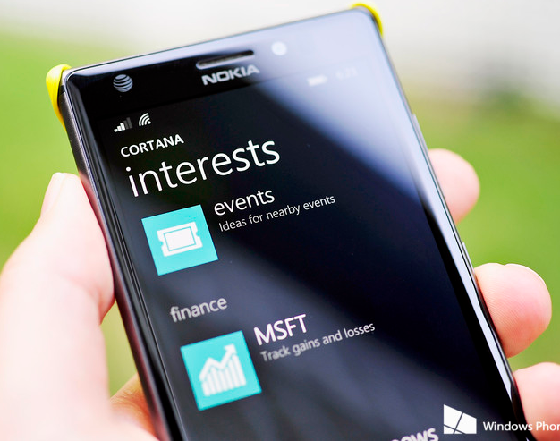
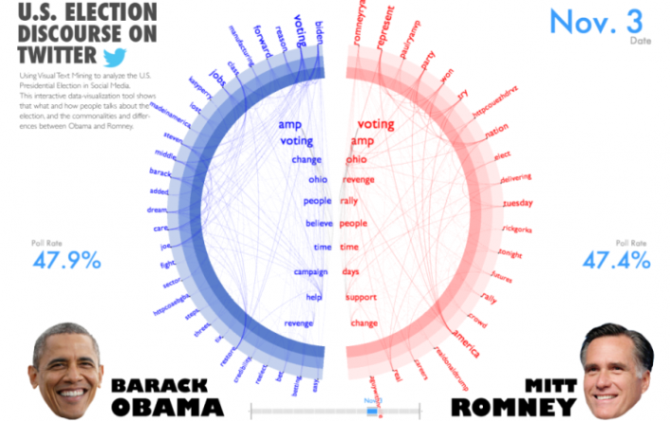
Applications of Event Identification and Analysis
Event Recommendation
Event Identification and Analysis on Twitter
Stock Market Prediction
Opinion Analysis

Slide 7
This Talk
A unified model for topics, events and users on Twitter [Diao & Jiang, EMNLP’13]
Related work
Our model
Experiments
Conclusions

Slide 8
Related Work
Event detection ([Sakaki et al. 2010] [Petrovic et al. 2010] [Weng & Lee, 2011] [Becker et al. 2011] [Li et al. 2012])
Online, real-time, early detection
Temporal topic modeling
Fixed number of topics ([Blei & Lafferty, 2006] [Wang & McCallum, 2006] [Wang et al. 2007])
Non-parametric ([Ahmed & Xing, 2008] [Ahmed et al. 2011] [Tang & Yang, 2012])
Applied to news articles

Slide 9
Chinese Restaurant Process
Chinese Restaurant Process
Traditional Generative Clustering Model
Fix number of clusters: 2
Items:
…

Slide 10
Recurrent Chinese Restaurant Process
items:
…
…
…
t-1
t
t+1

Slide 11
Recurrent Chinese Restaurant Process
RCRP
Events on date t-1
Super bowl
Concert
Traffic accident
11
Super bowl
Concert
Traffic accident
Fashion show
Events on date t
$$3+1$$
$$2+0$$
$$1+0$$
$$α$$
$n_{k,t−1}+n_{k,t}^{(i)}$ for existing event $k$
…
…
$α$ for a new event
t

Slide 12
Limitations of Directly Applying RCRP
Not every tweet is event-related
Our solution: separate tweets into personal topic-related tweets and event-related tweets
RCRP models the “rich-get-richer” phenomenon but not the burstiness of events on social media
Social media items have two properties: imitation and recency [Leskovec et al. 2009]
Our solution: penalize event clusters that have long durations

Slide 13
Base Model
H
Topic
T
Event
Personal Interests
Tweets on date t
H
H
Sports 0.3
Sports
Food
Food 0.2
T
…
Concert
Music 0.1
$$\frac{3+2}{6+3+α}$$
$$\frac{2+1}{6+3+α}$$
$$\frac{1+0}{6+3+α}$$
$$\frac{α}{6+3+α}$$
Super bowl
Concert
Traffic accident
Fashion show
Events on date t
Super bowl
Concert
Traffic accident
Events on date t-1
RCRP

Slide 14
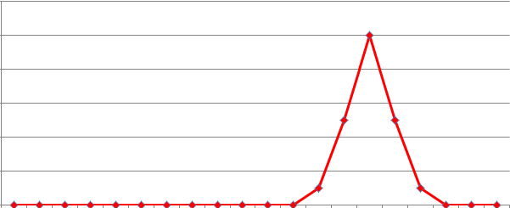
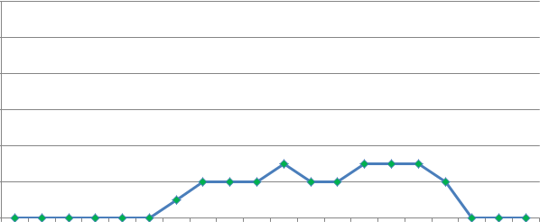
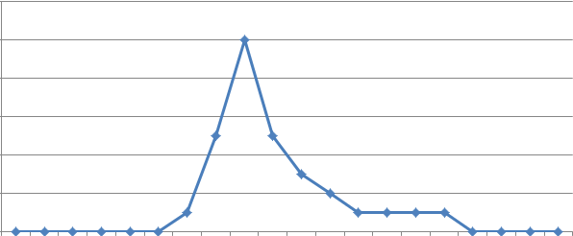
Duration-based Regularization
Date t
Super bowl
Concert
Traffic accident
Super bowl
Concert
Traffic accident
Fashion show
Events on date t
Super bowl
Concert
Traffic accident
Events on date t-1
RCRP

Slide 15
Relating Events to Topics
In the base model, tweets are separated into two types:
Topic tweets: each tweet belongs to one of a fixed number of general topics
Event tweets: each tweet belongs to an event cluster modeled by RCRP
How can we model and capture the correlations between events and topics?

Slide 16
Event-topic Affinity Vector
Inner
Popularity
Event-Topic Affinity Vector
Super bowl
Sports 0.6
0.8
+
Music 0.2
…
Sports 0.3
Fashion 0.1
Music 0.2
Sports 0.1
…
Fashion show
Fashion 0.1
0.3
+
Music 0.1
…
dot product
Fashion 0.7
Super bowl
Concert
Traffic accident
Fashion show
Events on date t
Super bowl
Concert
Traffic accident
Events on date t-1
RCRP

Slide 17
The Model
Base+Reg+Aff
Base
Base+Reg
$$α$$
$$ι$$
∞
$$ε$$
$$η_{k}^{0}$$
$$η_{k}^{}$$
$$θ_{1}^{rcrp}$$
$$θ_{t}^{rcrp}$$
$$θ_{T}^{rcrp}$$
D_{t}
U
$$s_{t,i}$$
$$c_{t,i}$$
$${\overline{z}}_{u}$$
N₁
N_{t}
N_{T}
∞
$$s_{1,i}$$
$$s_{t,i}$$
$$s_{1,i}$$
$$λ$$
T
$$ρ_{k,t}$$
$$r_{t,i}$$
$$y_{t,i}$$
$$π_{u}$$
…
…
$$z_{t,i}$$
$$θ_{u}$$
$$w_{1,i}$$
$$w_{t,i}$$
$$w_{T,i}$$
$$ψ_{k}$$
A
$$φ_{a}$$
$$w_{t,i,j}$$
The idea: If timestamps of tweets in the event cluster deviate much from t, the probability of observing r becomes smaller.
$$r_{t,i}=Berboulli(ρ_{s_{t,i},t})$$
$$c_{t,i}∼Gaussian\left(η_{s_{t,i}}^{0}+η_{s_{t,i}}^{}∗{\overline{z}}_{u_{t,i}},ε^{−1}\right)$$
$${\overline{z}}_{u,a}= \frac{{\overline{C}}_{u,a}}{\sum_{a′=1}^{A}{{\overline{C}}_{u,a′}}}$$
$$ρ_{k,t}=exp⁡(−\sum_{t^{′}=1,\left|t^{′}−t\right|>1}^{T}{λ|t^{′}−t|n_{k,t′}})$$
Balasubramanyan and Cohen (SDM 2013)

Slide 18
Experiments
Dataset:
500 users randomly selected from ~150K Singapore Twitter users
Their tweets from with 1st April 2012 to 30th June 2012
655,881 tweets in total
Methods for comparison
TimeUserLDA: Diao et al. (2012) “Finding bursty topics from Microblogs”
Base: Our method without time duration regularization and event-topic affinity.
Base+Reg: Our method without event-topic affinity.
Base+Reg+Aff

Slide 19
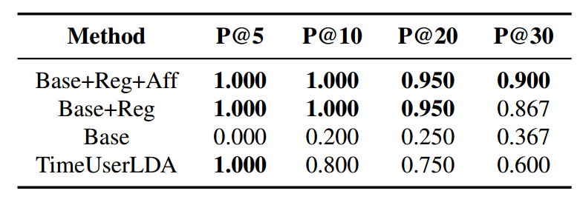
Quality of Most Popular Events
Ground truth generation:
For each method, rank identified events by its magnitude.
Merge top-30 events from each method, then randomly pick 100 tweets from each event.
For each event, provide the 100 tweets to two human judges, and ask them to score 1 (true )or 0 (false). Only when both judges score 1, we treat the event as true. (0.744 Cohen’s Kappa)
Quality of top events:
Table 1: Precision@K for the various methods

Slide 20
Quality of Most Popular Events
Top 5 events identified by Base+Reg+Aff:
Label | Top Words | Period | Inner Popularity
Debate Caused by Manda Swaggie | singapore, bieber, europe, amanda, justin | 17 June ~ 19 June | 0.9457
Indonesia Tsunami | Tsunami, earthquake, indonesia, singapore, hit | 10 April ~ 12 April | 0.9439
SJ encore concert | #ss4encore, cr, #ss4encoreday2, hyuk,120526 | 26 May ~ 28 May | 0.8360
Mother’s Day | Day, happy, mother’s, mothers, love | 11 May ~ 14 May | 0.9370
April Fools’ Day | April, fools, day, fool, joke | 1 April ~ 3 April | 0.9322
Table 2: The top 5 events identified by our model, in which story name is manually labeled.

Slide 21
Event Recommendation
Event recommendation:
Purpose: recommend an event to the users who have not posted on it.
April & May 2012
June 2012
Topics
&
Events
Events
We randomly pick half of the users to learn the events in June, and we pick 8 common ones shared by most methods.
500 Users
Recommend
We randomly pick 100 users from the remaining 250 users, and read their tweets to justify whether they tweet on the 8 events.
Our method(Base+Reg+aff): we rank the 100 users based on $η_{k}∗{\overline{z}}_{u}$, for each event.
The other methods: we use a collaborative filtering strategy. We rank the 100 test users by their similarity with these training users who have tweeted about the event.

Slide 22
Results of Event Recommendation
Event recommendation:
Event | TimeUserLDA | Base | Base+Reg | Base+Reg+Aff | Inner Popularity
E1 | 0.3533 | 0.3230 | 0.3622 | 0.2956 | 0.943
E2 | 0.3811 | 0.3525 | 0.3596 | 0.4362 | 0.917
E3 | 0.1406 | 0.1854 | 0.1533 | 0.1902 | 0.893
E4 | N/A | 0.2832 | 0.1874 | 0.3347 | 0.890
E5 | N/A | 0.1540 | 0.1539 | 0.1113 | 0.876
E6 | N/A | 0.0177 | 0.0331 | 0.2900 | 0.862
E7 | N/A | 0.0398 | 0.0330 | 0.5900 | 0.792
E8 | 0.0711 | 0.1207 | 0.2385 | 0.3220 | 0.773
MAP | N/A | 0.1845 | 0.1901 | 0.3213
With the event-topic affinity vector, we can do better recommendation.
The event-topic affinity vectors are especially useful to recommend events that attract only certain people’s attention, such as those related to sports, music, etc.
Table 4: For the 8 events that happened in June 2012, we compute the Average Precision for each event. We also show the Mean Average Precision when applicable.

Slide 23
Example Events
Grouping events by topics:
Table 4: Example topics and their corresponding highly related events.

Slide 24
Conclusions
We proposed a unified model for events, topics and user interests on Twitter
The model can identify meaningful events
The model can identify users’ personal topical interests
The model can align events with general topics
Future work
Event labeling/summarization
Modeling event evolution

Slide 25
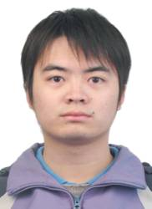
Acknowledgment
Qiming Diao
LARC

Slide 26
Thank You!
Questions?

Slide 27
Our Work
Finding bursty topics from microblogs [Diao et al., ACL’12]
We designed a TimeUserLDA model to find bursty topics (where the number of topics is fixed) and used a two-state machine to perform post-processing on the bursty topics to identify events
Recurrent Chinese restaurant process with a duration-based discount for event identification from Twitter [Diao & Jiang, SDM’14]
We used non-parametric models to identify events (where the number of events is not fixed). The model is modified from Recurrent Chinese Restaurant Process (RCRP) by Ahmed & Xing [SDM’08].

